Slide 1
Web development
D a y 1
By Rajdeep Karmakar

Slide 2
Today’s Topics:
There’s what you’ll find in this Slidesgo template:
Introduction
How website works.

Slide 3
01
Intro
The so called “INTRO” from me! 🙂

Slide 4
“Every great website starts with a single line of code, and today marks the beginning of your journey to build something incredible.”

Slide 5
02
How website works

Slide 6
How Website works?!
Topics covered: Frontend, backend, database, DNS, IP Address
Website:
A website is a collection of related web pages that are hosted on a server and accessible through the internet. Each website has a unique domain name (like example.com) that users can visit using a web browser (Chrome, Firefox, etc.).
When a user types a website URL in the browser, it sends a request to the web server hosting the website. The server processes the request and sends back the required web page.

Slide 7



We have to understand some parts of website
Frontend
Backend
Database
The frontend is the part of a website that the user interacts with. It includes everything you see and interact with in the browser—text, images, buttons, forms, etc.
The backend is the part of a website that runs on the server and handles all the logic, database interactions, and operations not visible to the user.
A database is a structured collection of data that websites or applications use to store, manage, and retrieve information efficiently.

Slide 8

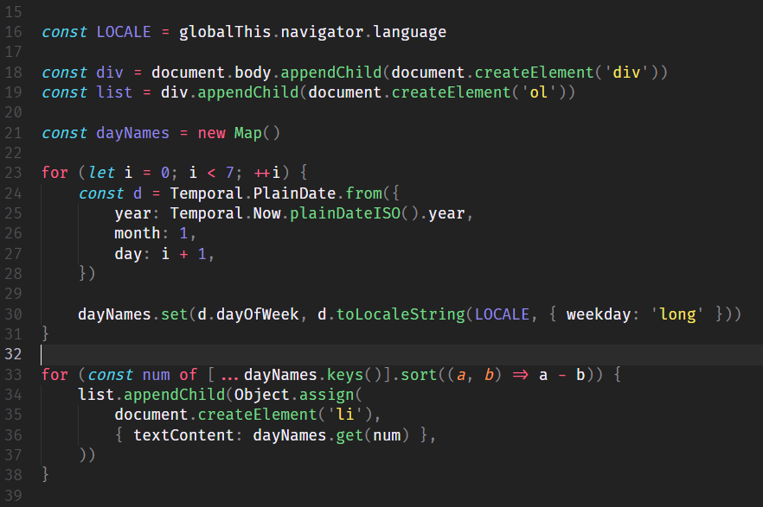
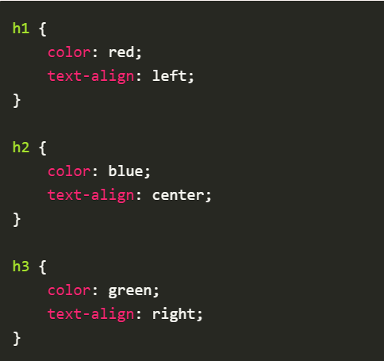
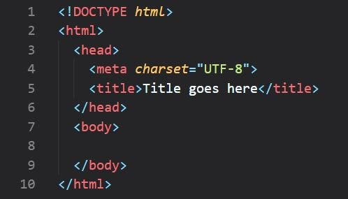

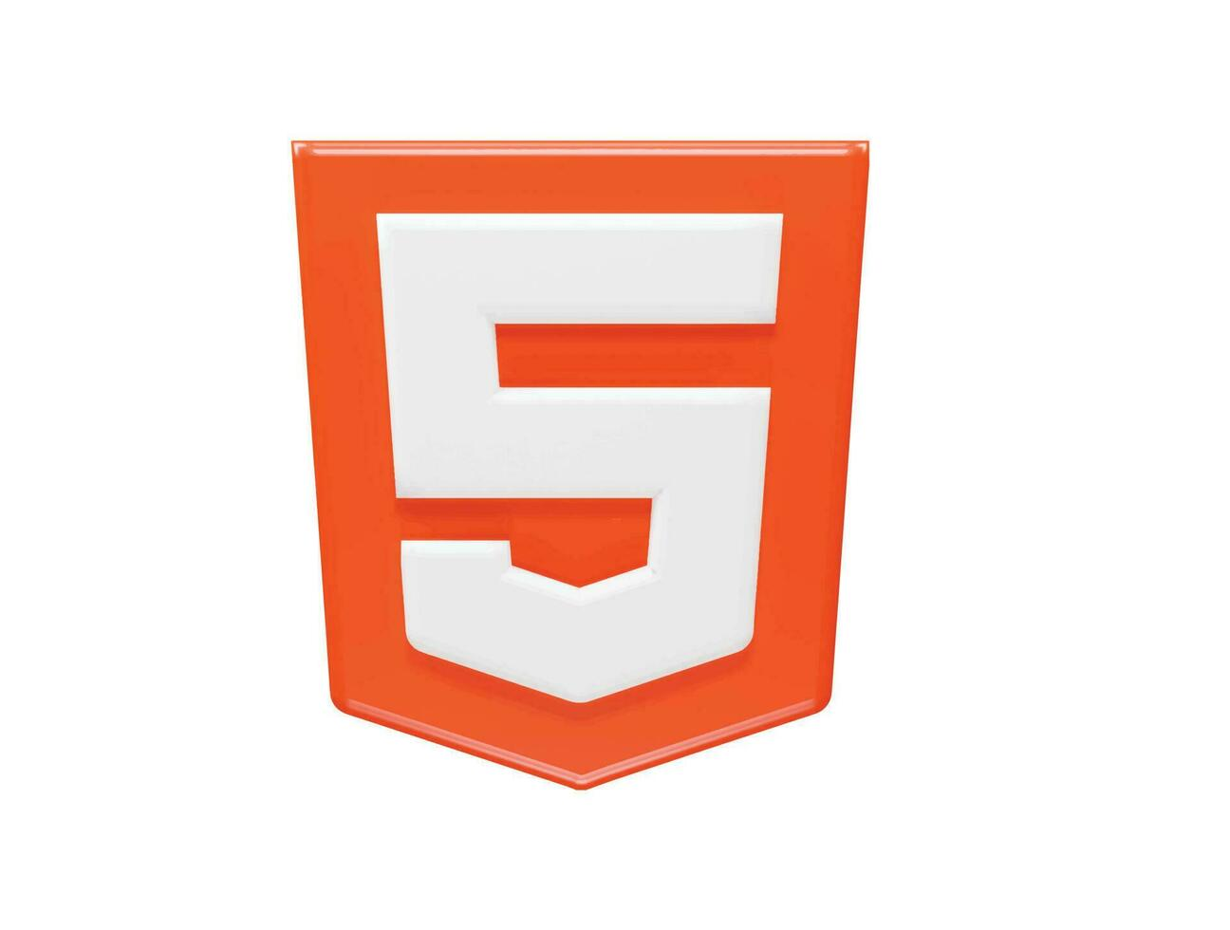
Frontend:
Technologies used in the frontend:
HTML: The structure and content of a webpage (e.g., text, images, headings).
CSS: The design and layout (e.g., colors, fonts, positioning).
JavaScript: Adds interactivity (e.g., animations, form validations).
How it Works:
1) The browser sends a request to the web server.
2) The server responds with an HTML file (sometimes with CSS and JavaScript).
3) The browser interprets and renders the webpage for the user.
Javascript
CSS
HTML

Slide 9
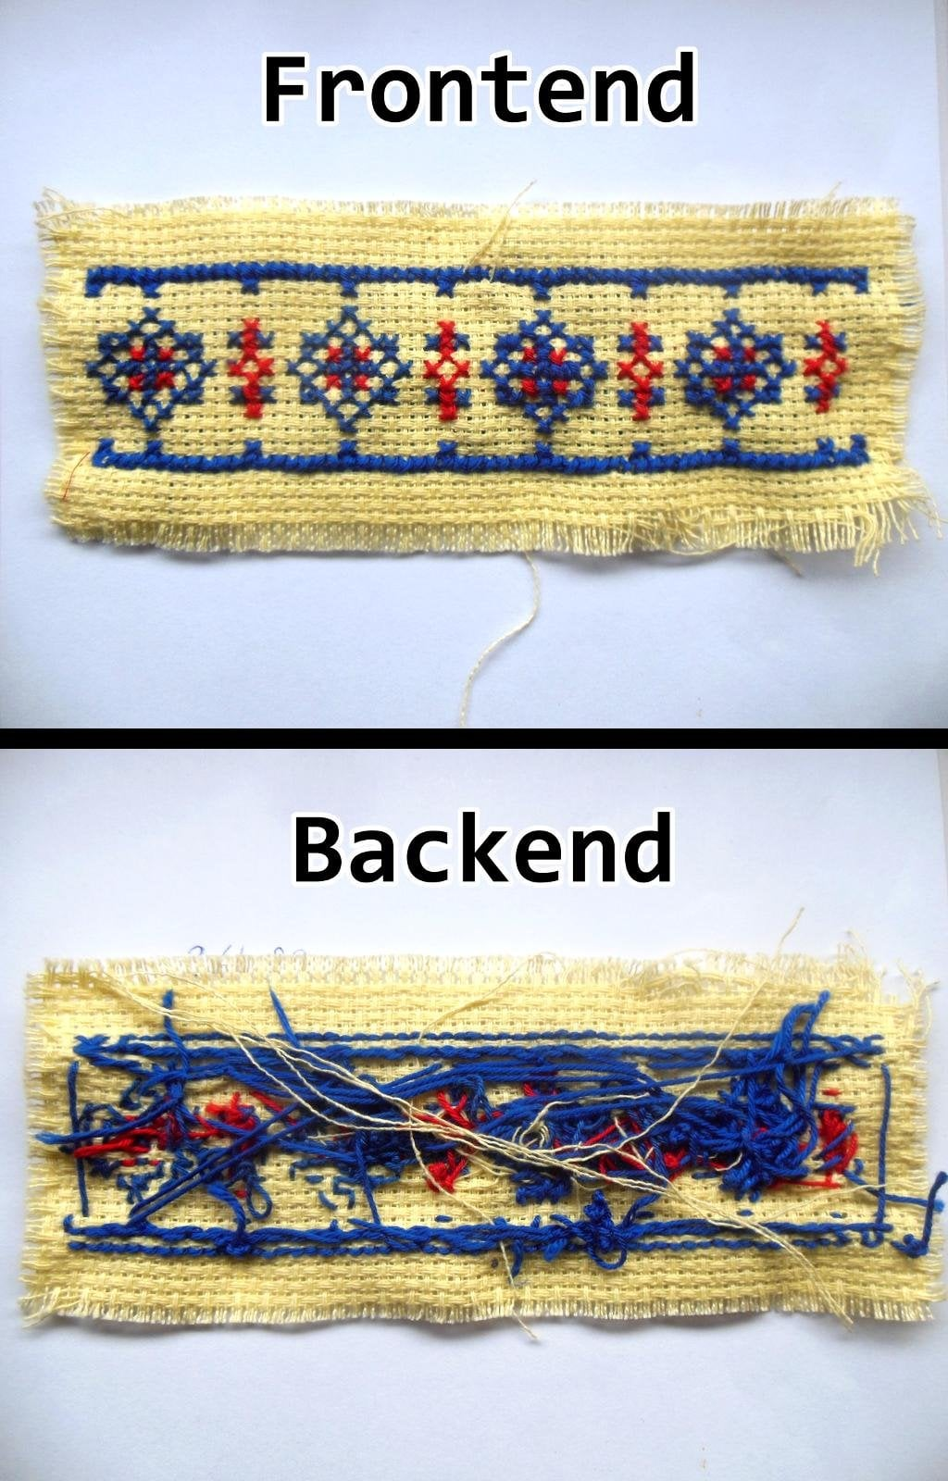
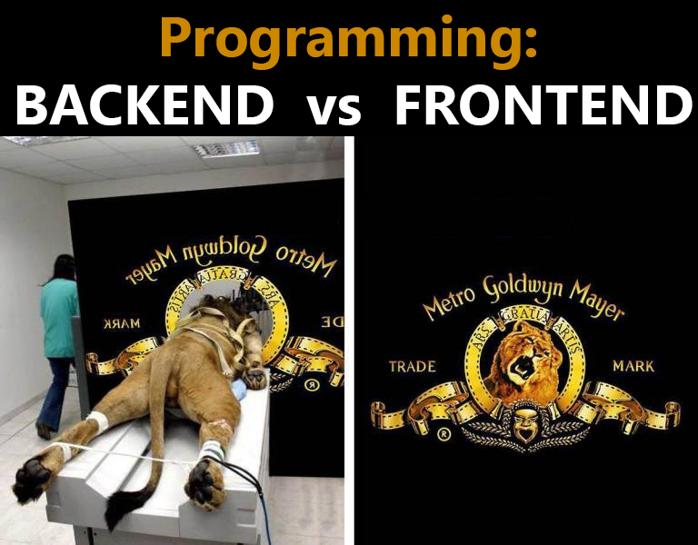
Backend:
Technologies used in the frontend:
Server-Side Languages: (e.g., Node.js, Python, PHP, Ruby) process requests, handle logic, and interact with databases.
Database: Stores the data that the website needs (e.g., user profiles, blog posts, product listings).How it Works:
1) When a user submits a form (e.g., a login form), the browser sends the data to the server.
2) The server processes the data, interacts with the database, and returns the result (e.g., a success message or an error).

Slide 10
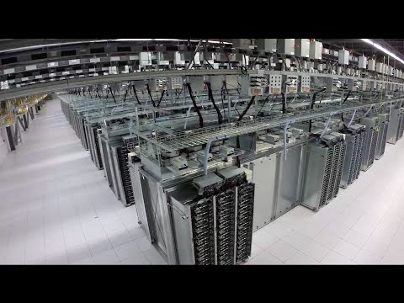
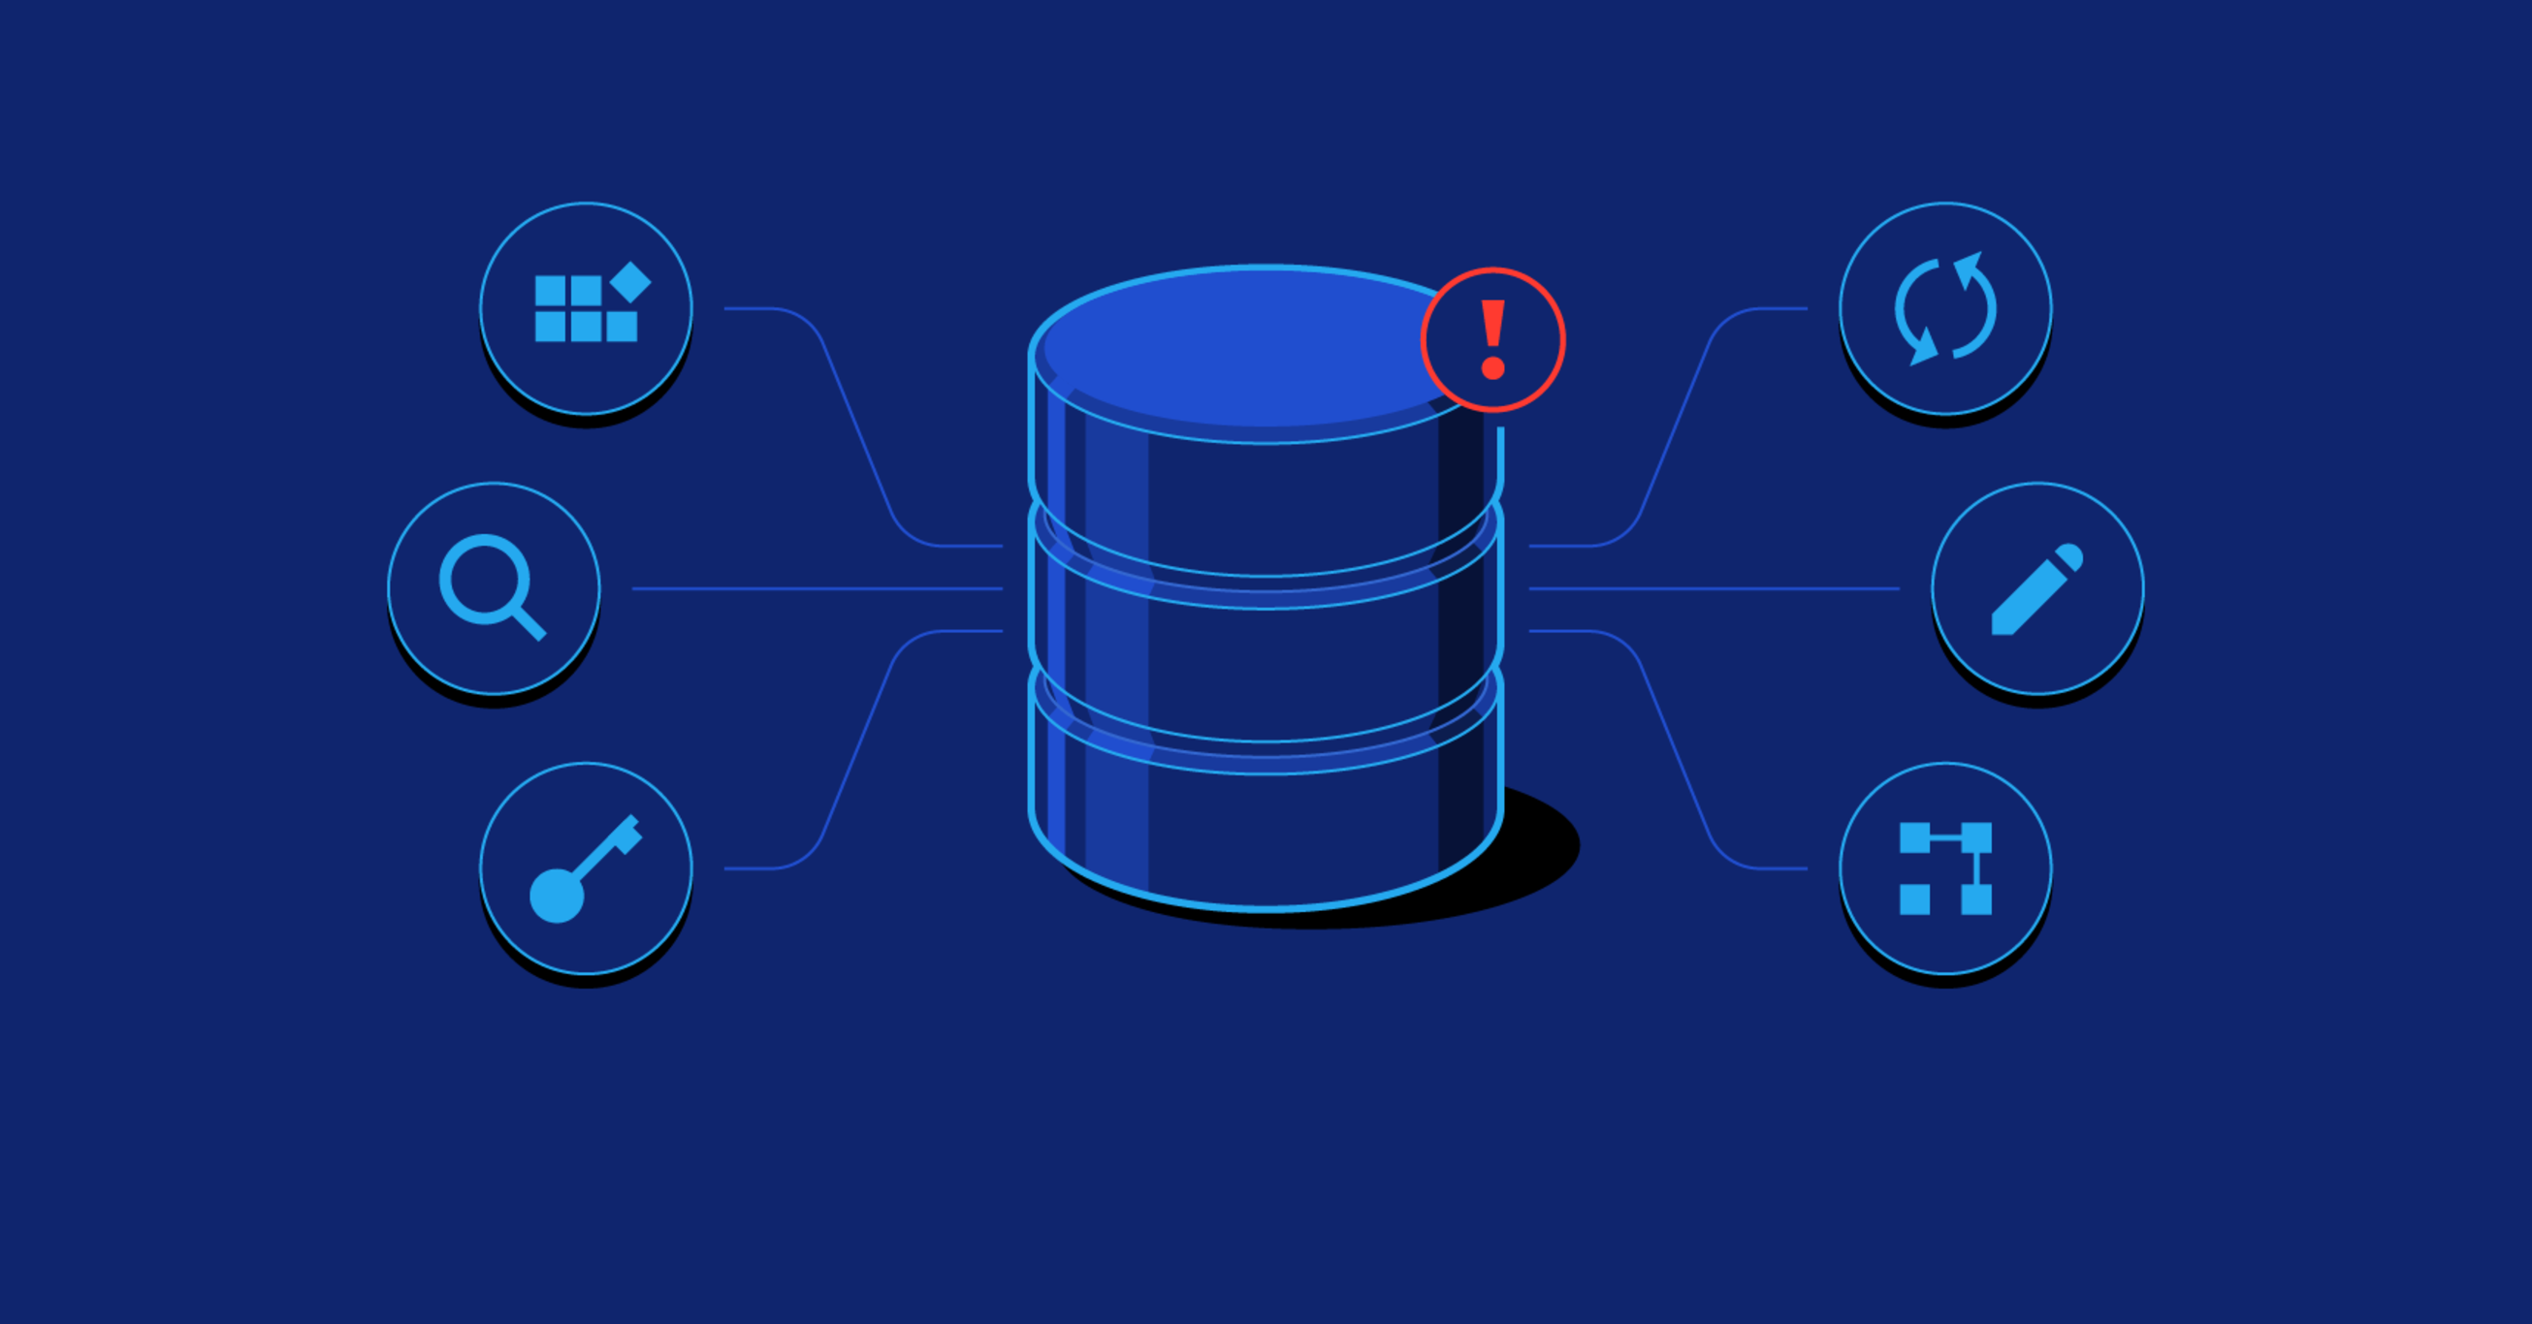
Database:
Technologies used in the frontend:
SQL (Structured Query Language) databases like MySQL, PostgreSQL.
NoSQL databases like MongoDB (used for large sets of unstructured data).
How it Works:
Backend applications communicate with the database to fetch or store information. For instance, when you log in, the backend checks your credentials against the stored data in the database.

Slide 11
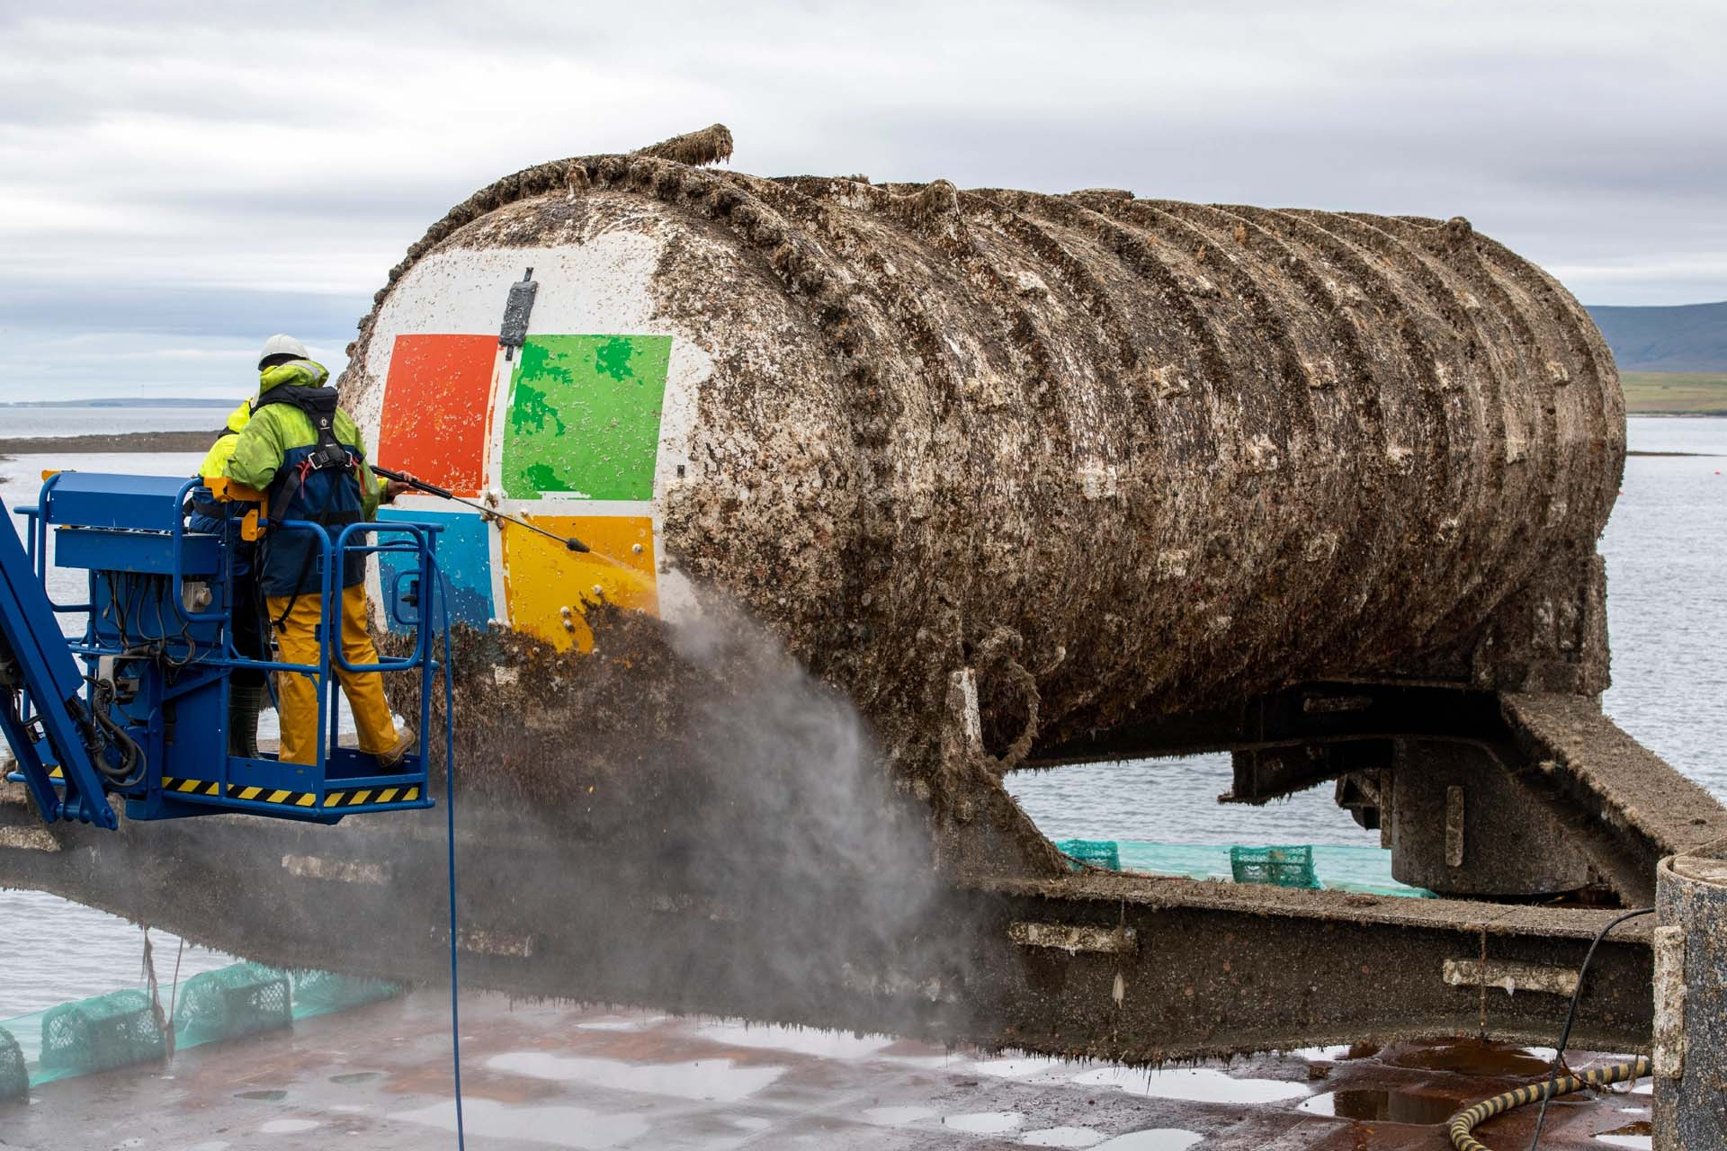
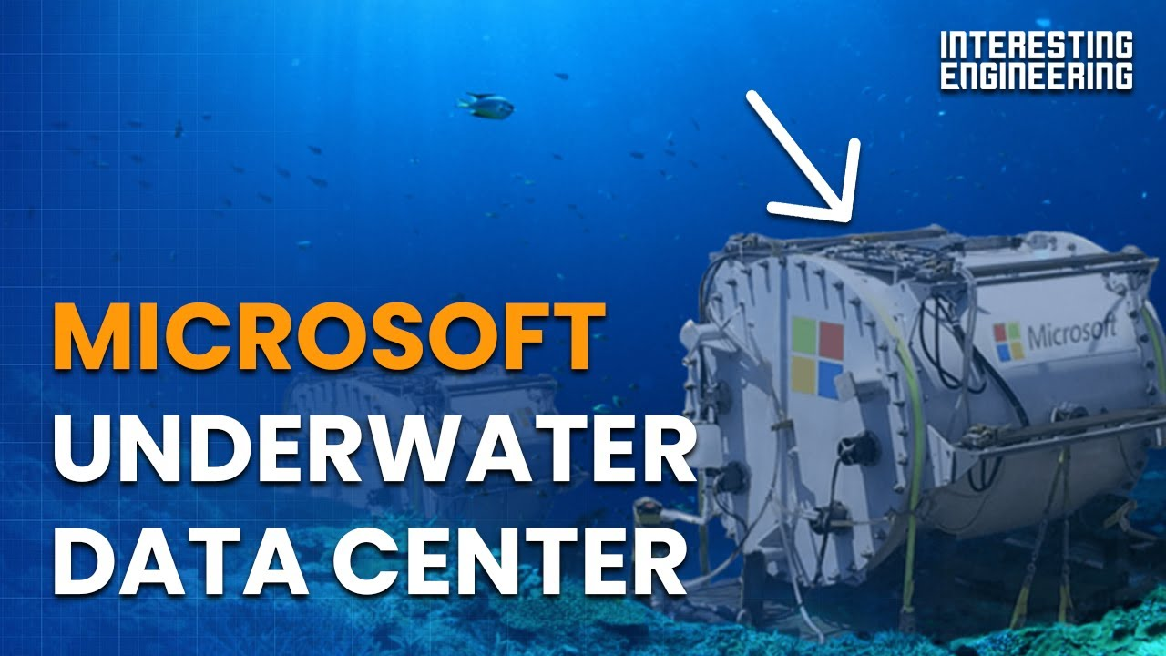
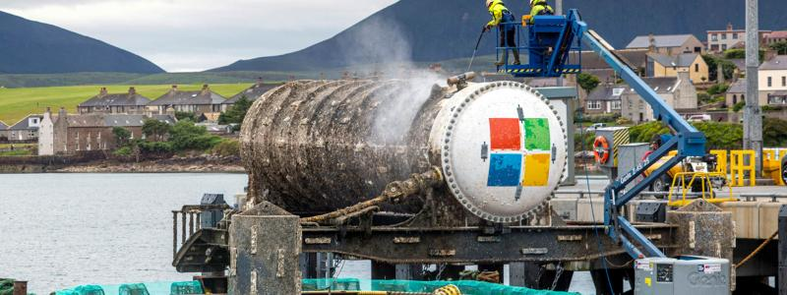
Database

Slide 12
Thank You!

